Slide 1
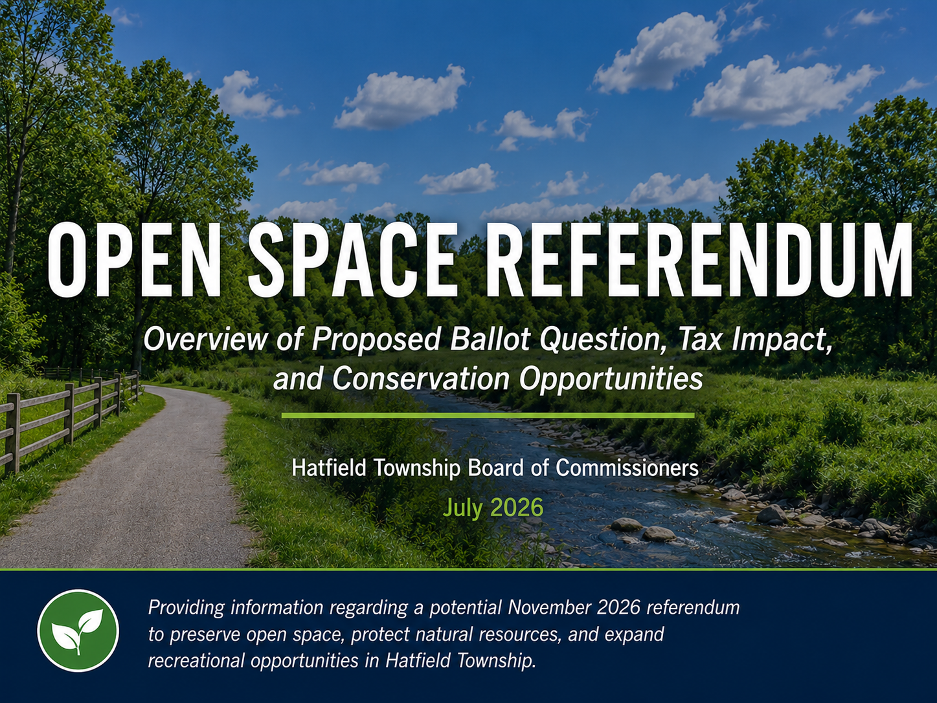

Slide 2

The Question
“Do you favor the imposition of an additional Earned Income Tax at the rate of one quarter of one percent (0.25%) by Hatfield Township for the purpose of acquiring lands and other interests in real property to preserve undeveloped land and expand opportunities for outdoor recreation; retire indebtedness and to pay transactional fees incidental to such acquisitions; pay other expenses for the preparation of resource, recreation, or land-use plans related to such acquisitions; and finance the expenditure of up to 25% of annual revenue for the development, improvement, design, engineering, and maintenance of lands acquired for an open space benefit or benefits?”

Slide 3
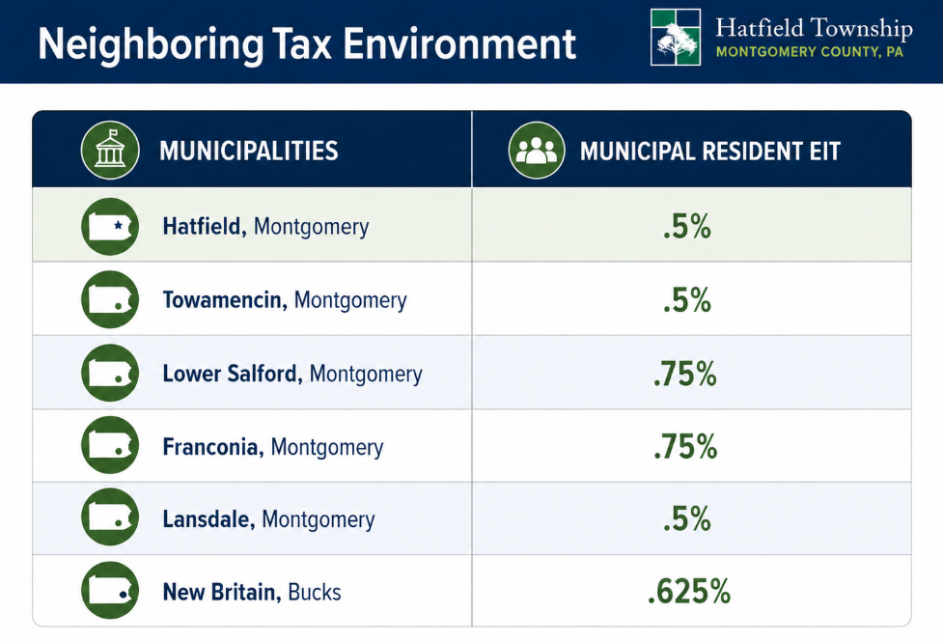
Neighboring Tax Environment
Municipalities | Municipal Resident EIT
Hatfield, Montgomery | .5%
Towamencin, Montgomery | .5%
Lower Salford, Montgomery | .75%
Franconia, Montgomery | .75%
Lansdale, Montgomery | .5%
New Britain, Bucks | .625%

Slide 4
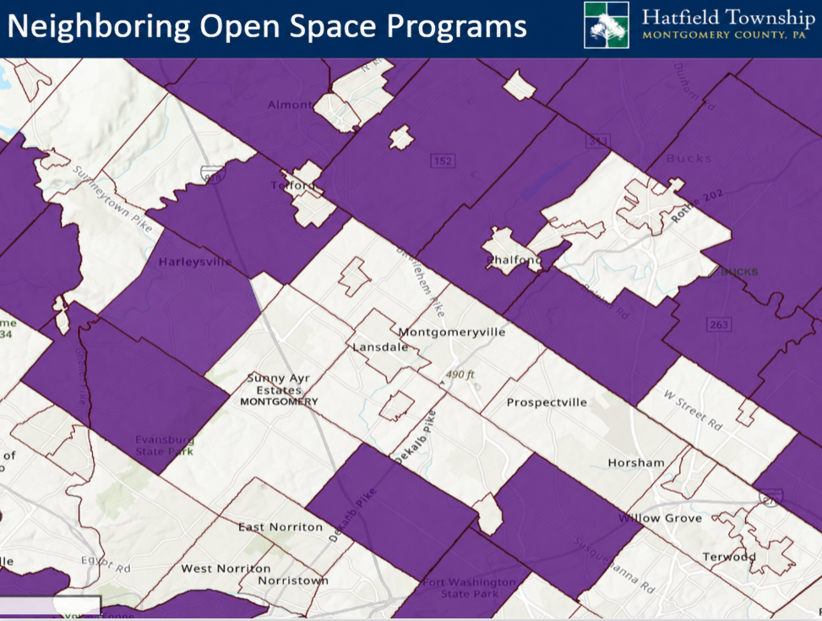
Neighboring Open Space Programs
Notes:
Purple munis have open space funds

Slide 5
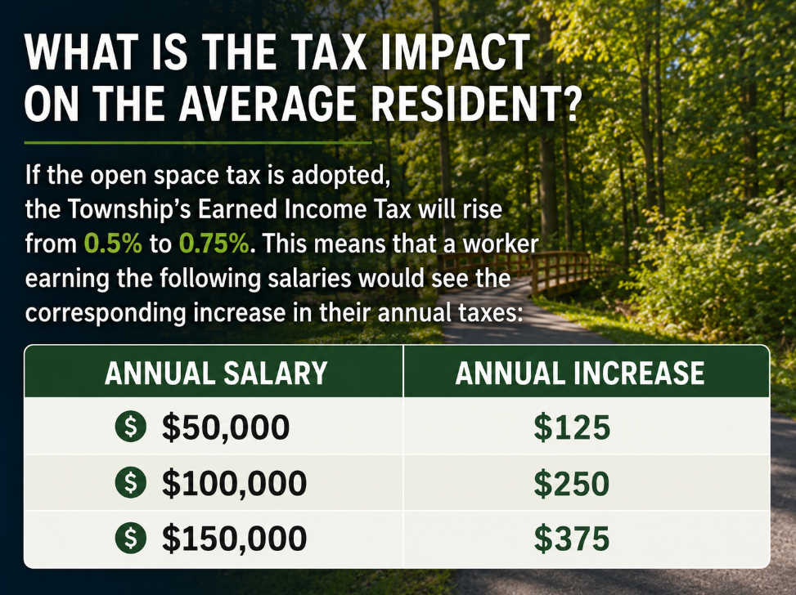
What is the tax impact on the average resident?
If the open space tax is adopted, the Township’s Earned Income Tax will rise from 0.5% to 0.75%. This means that a worker earning the following salaries would see the corresponding increase in their annual taxes:
Notes:
Average additional $225.38 per year or $18.78 per month
On $100,000 salary, it’s $250 per year or $20.83 per month

Slide 6
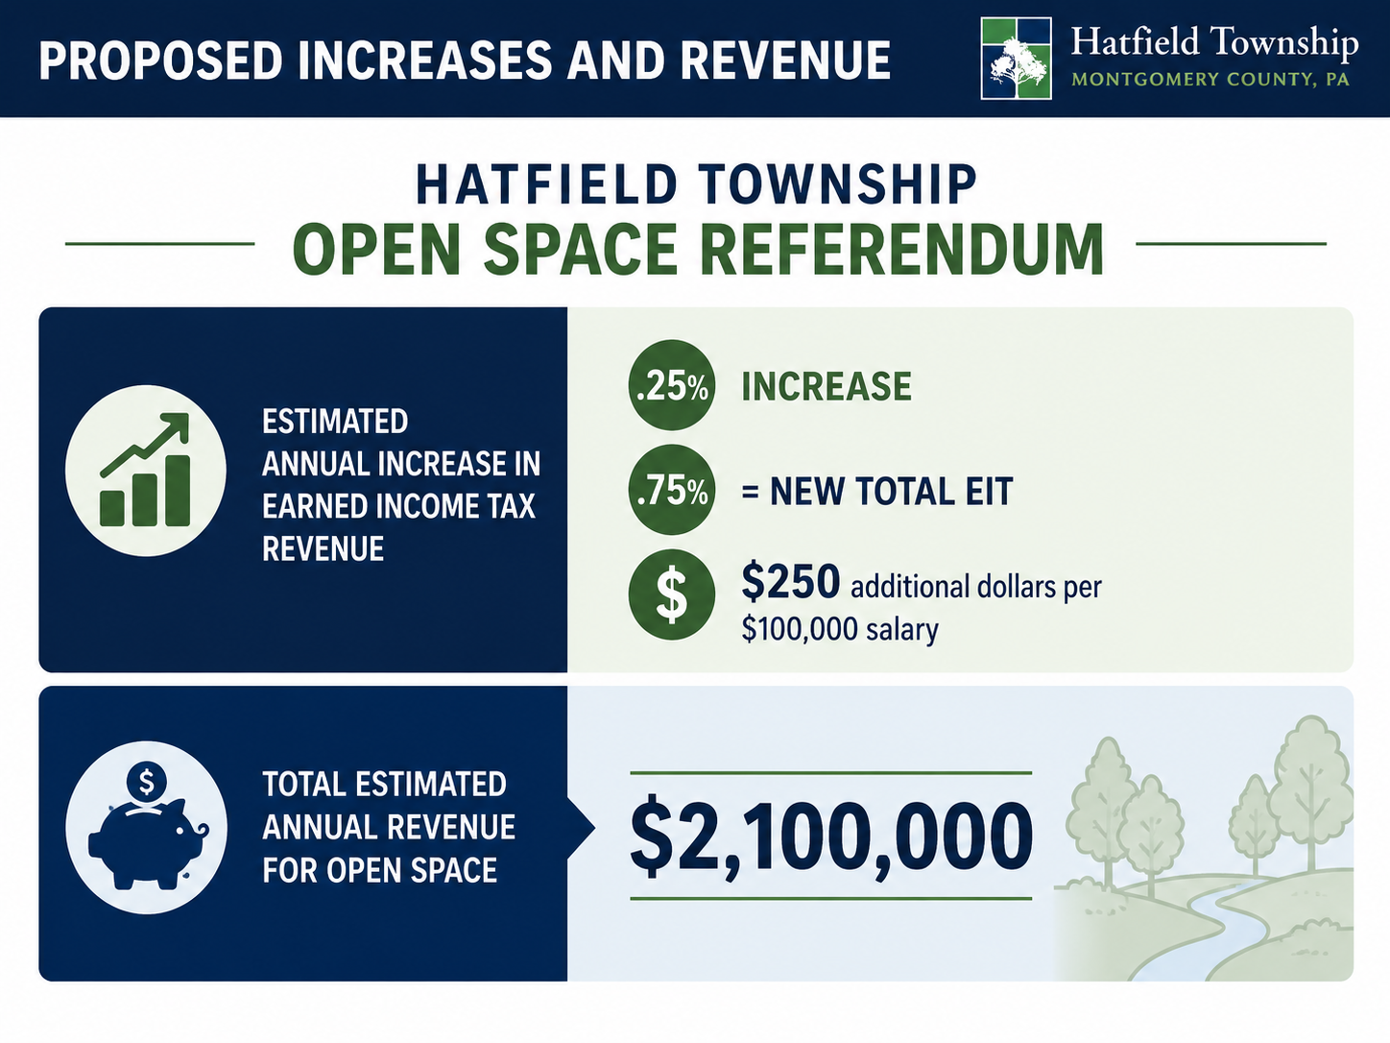
Proposed Increases and Revenue
Hatfield Township Open Space Referendum
Estimated Annual Increase in Earned Income Tax Revenue | .25% Increase .75% = new total EIT $250 additional dollars per $100,000 salary
Total Estimated Annual Revenue for Open Space | $2,100,000

Slide 7
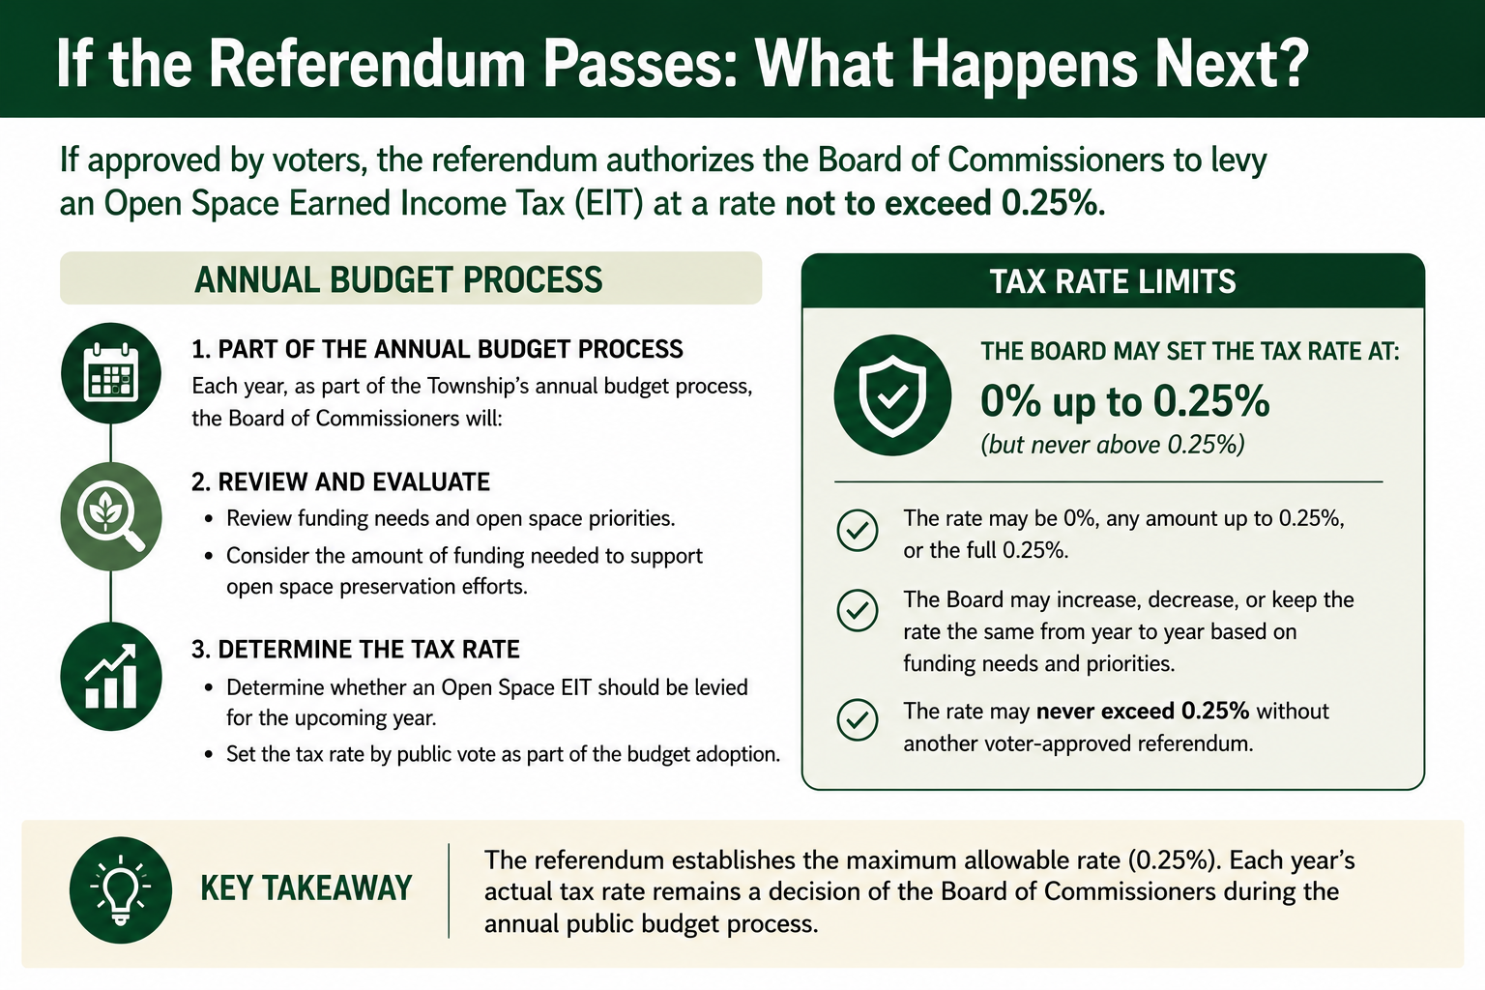
Annual process

Slide 8
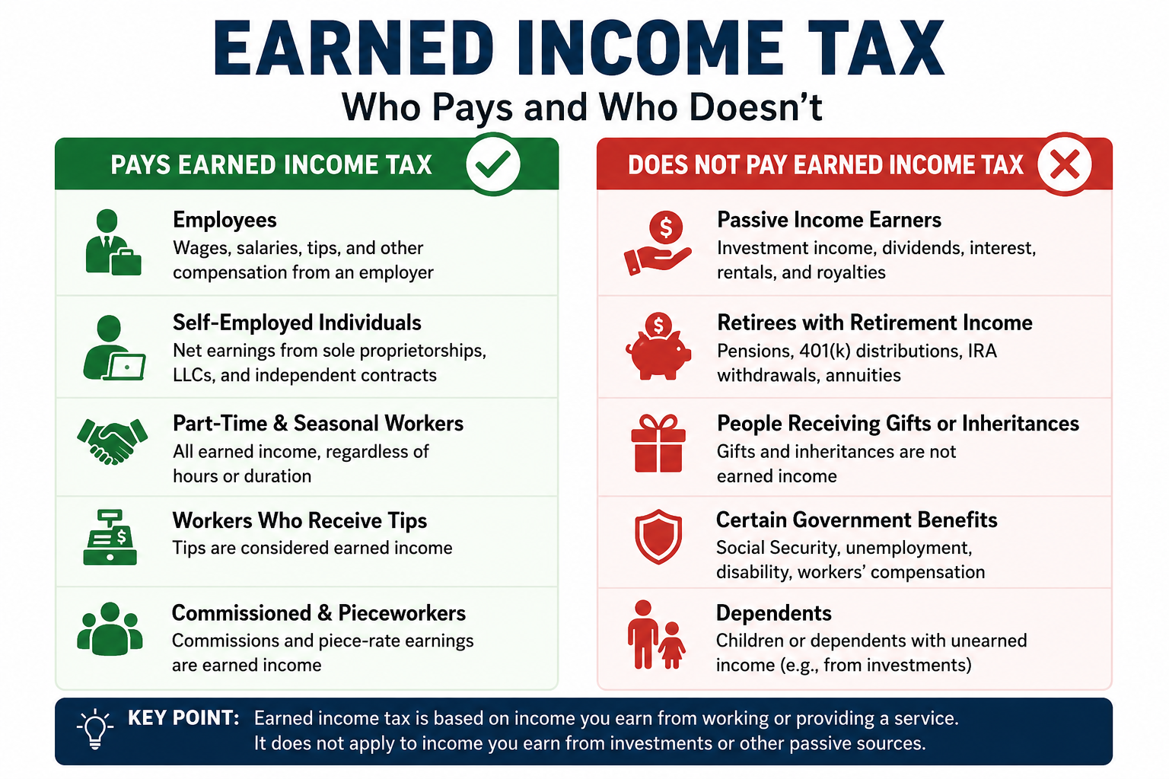
Who pays and doesn’t

Slide 9
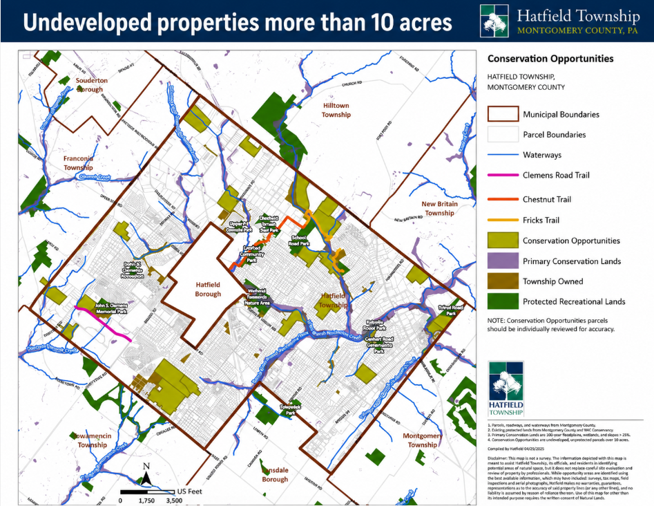

Slide 10
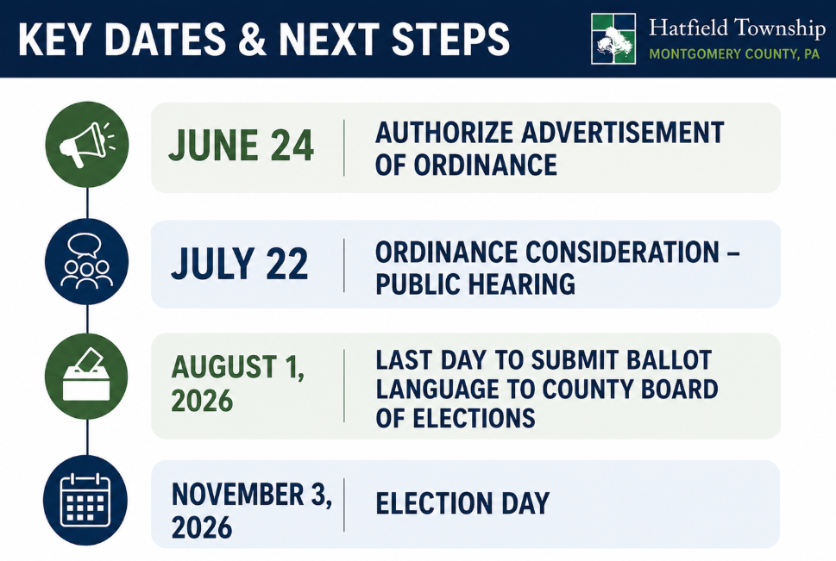
Key Dates & Next Steps
June 24: Authorize Advertisement of Ordinance
July 22: Ordinance Consideration – Public Hearing
Last Day to Submit Ballot Language to County Board of Elections: August 1, 2026
Election Day: 11/3

